Slide 1
PROJECT ON VIRTUAL
TICKETING SYSTEM

Slide 2

KISHKINDA UNIVERSITY BALLARI
INTERNAL GUIDE
Mr. SUKUMAR T
DEPARTMENT OF COMPUTER SCIENCE AND ENGINEERING
PROJECT TEAM MEMBERS:
K.NIVEDINI KUB23CSE052
SAI DEEPTHI .T KUB23CSE122
ANJALI KUB23CSE009
K.V. SAMANA KUB23CSE060
K.S. DEVIKA KUB23CSE058

Slide 3
INTRODUCTION:
Virtual ticketing system is a software application that helps business
To manage and track customer requests and support inquires.
Virtual ticketing system is designed to steamline the process of managing and issuing tickets for various events, transportation services, or customer services
It includes:
Virtual tickets, digital tickets, virtual help desk

Slide 4
KEY FEATURES :
1. User- Friendly interface
2. Real time ticket availability
3. Multiple payment options
4. Multi- language support

Slide 5
OBJECTIVES AND PURPOSES:
Purpose of a ticketing system is to process, prioritize, and manage customer issues from end to end.
Centeralized Repository: Collects and stores all service requests in single location.
Automated Processes: Streamlines the creation and management of tickets,including automated responses and routing.
Visibility and Transparency:Allows both customers and internal teams to track the status of requests,enhancing accountability and transparency
Data Reporting and Analytics:Offers insights into performance metrics and helps in identifying areas for improvement

Slide 6
CHOOSING THE RIGHT TICKETING MANAGEMENT SYSTEM
.Hosting Technology : opt for cloud-based systems for flexibility and reduced maintenance costs.
.Usability: ensure the system is user-friendly for both and customers.
.Customization and Integrations: choose a system that offers customization options and integrates well with other software tools.
.Alignment with ITIL: ensure the system aligns with ITIL best practices for efficient IT best practies for efficient IT service management

Slide 7
VISION OF VIRTUAL TICKETING SYSTEM
A virtual ticketing system for sports events envisions a seamless, engaging, and secure experience for fans, organizers, and venues. Key components include:
User-Friendly Platform: An intuitive interface for easy navigation, ticket selection, and purchase.
Mobile Access: A dedicated app for ticket purchases, event details, and real-time updates, allowing fans to access their tickets anywhere.
Dynamic Pricing: Adjustable pricing models that respond to demand, maximizing revenue while providing fans with competitive prices.
Secure Transactions: Advanced encryption and payment security to ensure safe transactions.

Slide 8
Digital Validation: Use of QR codes or mobile barcodes for quick
entry, minimizing wait times and enhancing security.
Seating Maps and Selection: Interactive seating charts allowing fans to choose their preferred seats and view sightlines
Event Notifications: Automated alerts for game updates, promotions, and special events to keep fans informed.
Social Sharing Options: Integration with social media for easy sharing of ticket purchases and event information, encouraging group attendance.

Slide 9
REQUIREMENTS
HARDWARE REQUIREMENTS
Storage: SSD storage for faster data access.
RAID Configuration: Use RAID-10 or RAID-5 for data redundancy and fault tolerance.
Web/Application Servers : CPU: Intel Xeon or AMD EPYC, 16-32 cores.
RAM: 32 GB – 64 GB OR 128 GB or Higher
Storage: 1 TB SSD (RAID-10 for redundancy).
Network: Dual 10 Gbps Ethernet.
Database Servers : CPU: Intel Xeon or AMD EPYC, 32+ cores.

Slide 10
SOFTWARE REQUIREMENTS
1. Web Application
Framework: VS(visual studio) Code , Python 3.12(64-bits) , Microsoft Powerpoint
2. Payment Processing
Payment Gateway Integration: Support for services like PayPal, or Square to handle secure transactions.

Slide 11
4. Customer Support Tools
Chatbot/Live Chat Software: Integration with services like Intercom or Zendesk for customer inquiries.
Email Marketing Software: Tools like Mailchimp for communication and promotions.
5. Backup and Recovery Software
Data Backup Solutions: Automated backup software for regular data protection.
Scalability: Ensure the software can handle increased traffic during peak sales periods.

Slide 12
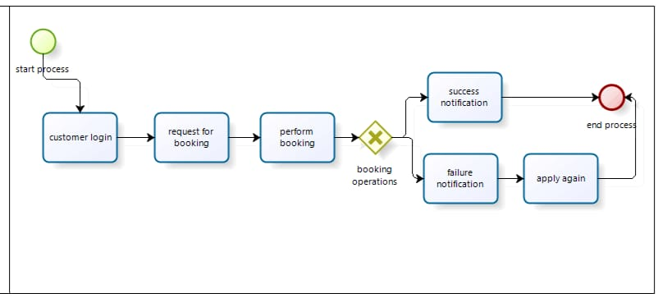
PROJECT ARCHITECTURE DIAGRAM

Slide 13
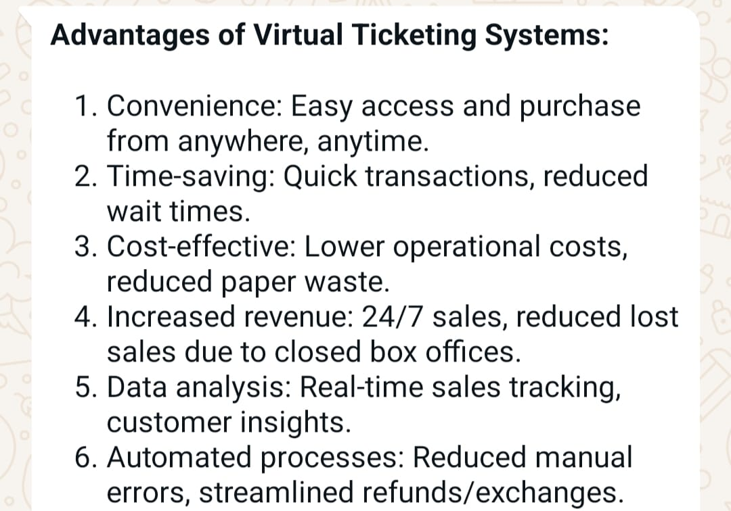
ADVANTAGES

Slide 14
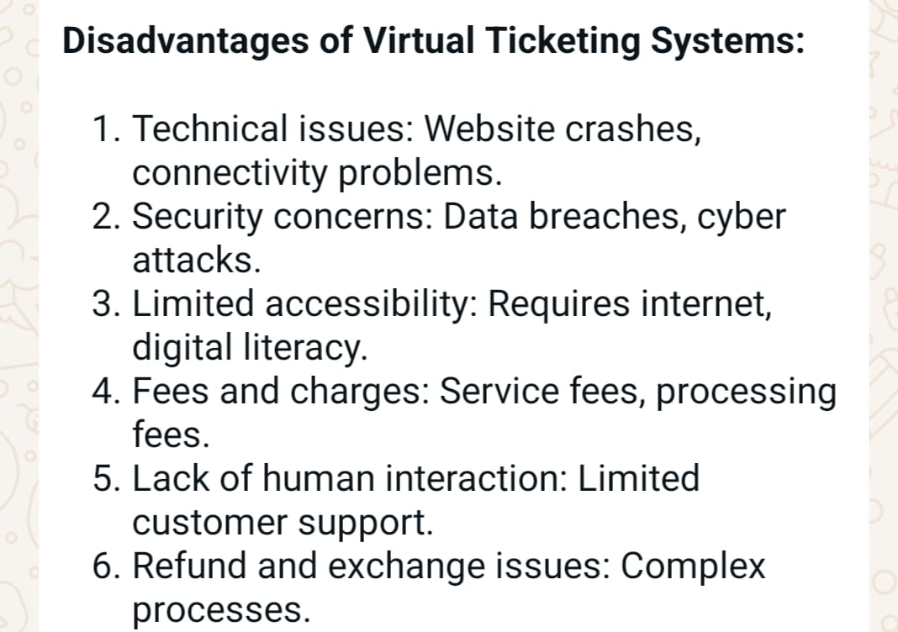
DISADVANTAGES

Slide 15
CONCLUSIONS
The Virtual Ticketing System revolutionizes the way tickets are handled in various industries by offering a modern, user-friendly, and efficient solution. It caters to both users and administrators, ensuring smooth operations and providing an enhanced customer experience.

Slide 16
FUTURE ENHANCEMENT
AI-Driven Suggestions: Use machine learning algorithms to analyze user preferences and suggest events, improving the likelihood of ticket sales.
Dynamic Pricing: Implement algorithms that adjust prices based on demand, user history, and real-time data.
Social Features
Group Ticketing: Allow users to purchase multiple tickets for friends and integrate with social media to coordinate events.
Event Sharing: Enable users to share their tickets on social platforms, creating organic marketing opportunities.

Slide 17
REFERENCES
https://www.greeksforgeeks.org referred by geeksforgeeks
https://www.slideshare.com
AUTOMATE THE BORING STUFF WITH PYTHON (2ND EDITION)
BY AI SWEIGART

Slide 18


